Slide 1
Graphs

Slide 2
Graphs can be of two types:
Directed
Undirected

Slide 3
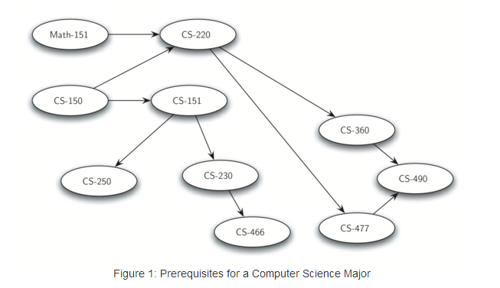

Slide 4
Tree can be referred to as a special kind of graph.

Slide 5
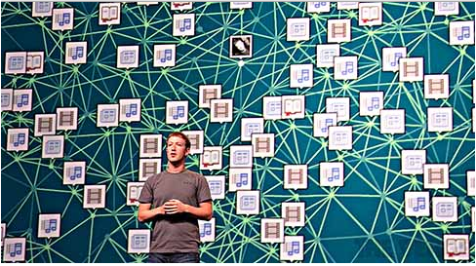


Slide 6
http://oracleofbacon.org/

Slide 7
Vertex (or Nodes)
Edges (or Links or arc): An edge connects two vertices to show that there is a relationship between them. Edges may be one-way or two-way. If the edges in a graph are all one-way, we say that the graph is a directed graph, or a digraph.

Slide 8
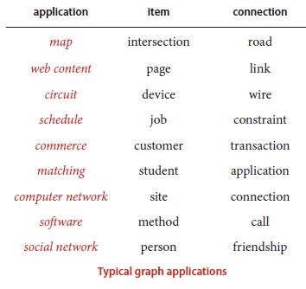

Slide 9
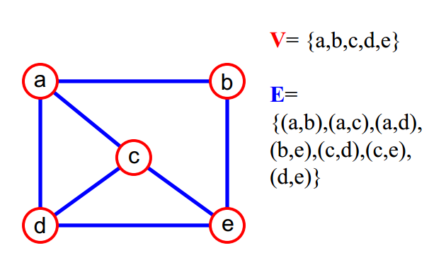

Slide 10
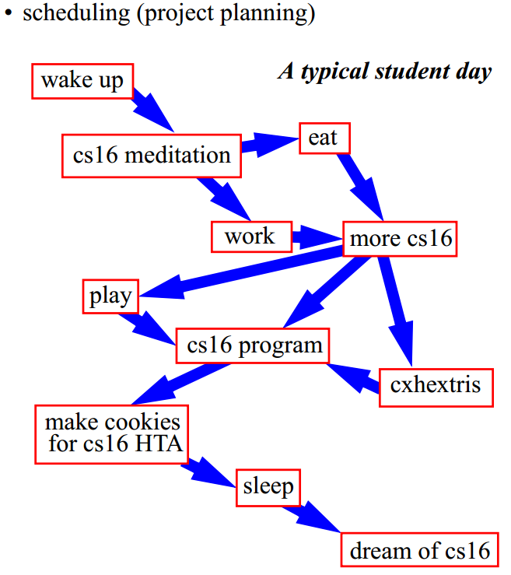

Slide 11
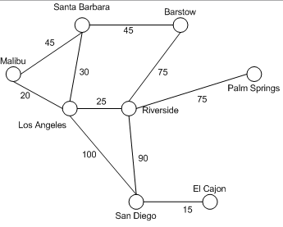
Adjacent vertices: Vertices connected by an edge.
Degree of a vertex: Number of adjacent vertices i.e. number of edges connected to a vertex.
Weights: Cost to go from one vertex to another.
Path: Sequence of vertices.

Slide 12
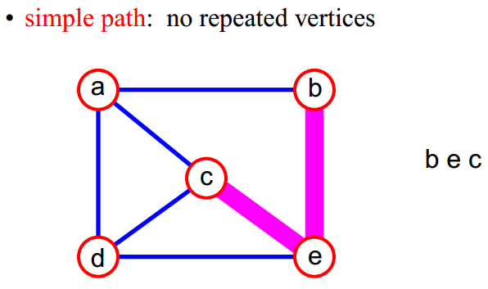

Slide 13
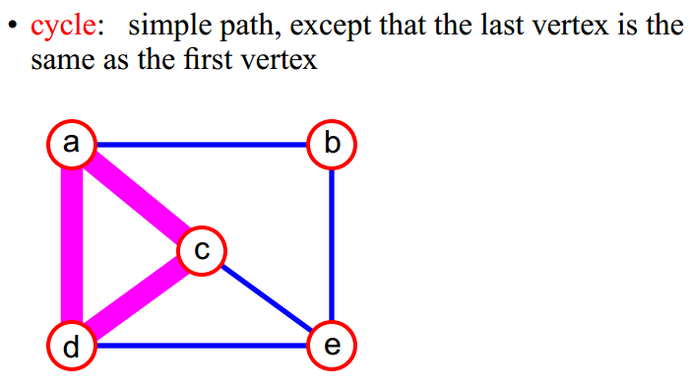
An acyclic graph is a graph with no cycles.

Slide 14
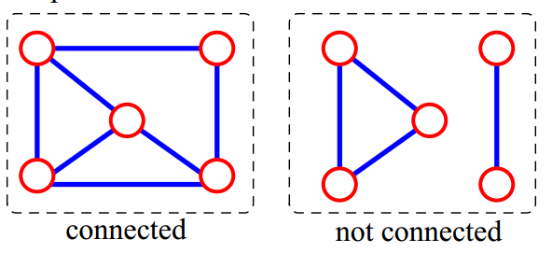

Connected graph: Any two vertices are connected by some path.

Slide 15
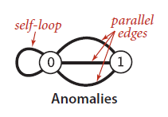
Anomalies. Our definition allows two simple anomalies:
A self-loop is an edge that connects a vertex to itself.
Two edges that connect the same pair of vertices are parallel.
Mathematicians sometimes refer to graphs with parallel edges as multigraphs and graphs with no parallel edges or self-loops as simple graphs.

Slide 16
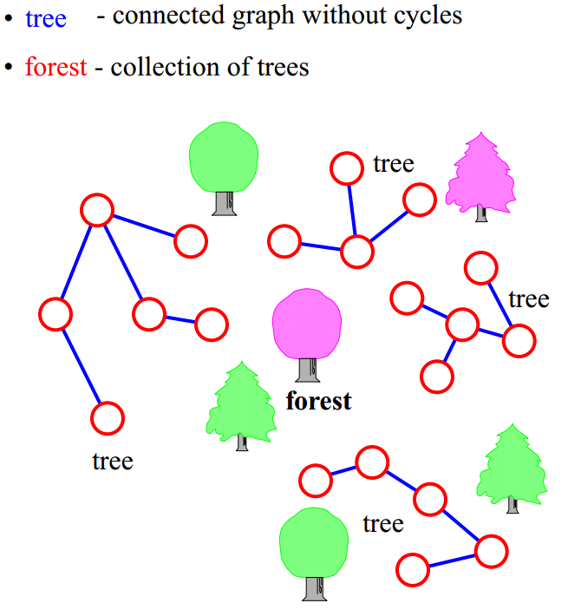

Slide 17
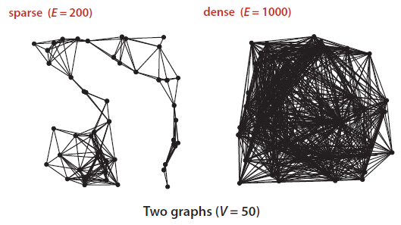
Density of a graph: The density of a graph is the proportion of possible pairs of vertices that are connected by edges.
Sparse graph: A sparse graph has relatively few of the possible edges present.
Dense graph: A dense graph has relatively few of the possible edges missing.

Slide 18
So how do we represent a graph?
Array of edges
Adjacency Matrix
Adjacency List
But we have two basic requirements:
We must have the space to accommodate the types of graphs that we are likely to encounter in applications.
We want to develop time-efficient implementations of Graph instance methods—the basic methods that we need to develop graph-processing clients.

Slide 19
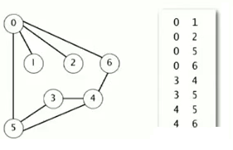
Array of Edges
Maintain an array of edges or linked list of edges.

Slide 20
Advantages
Easy to loop/iterate over all edges
Disadvantages
Hard to tell if an edge exists from A to B

Slide 21
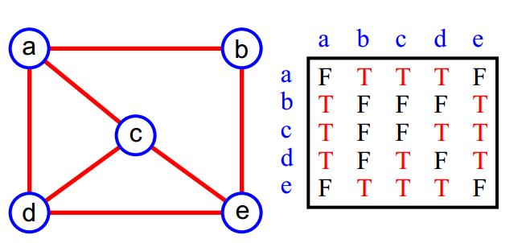
Adjacency Matrix
Two dimensional V by V array.
Each of the rows and columns represent a vertex in the graph.
The value at the intersection can be a boolean indicating that there is an edge between the two vertices or it can be a number indicating the weight of the edge.

Slide 22
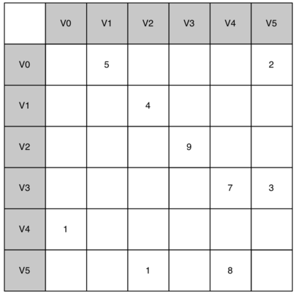
The advantage of the adjacency matrix is that it is simple, and for small graphs it is easy to see which nodes are connected to other nodes.
But, fails on the 1st requirement, i.e. need n^2 space for defining the graph. [Space=O(n^2)]
For sparse graphs, most cells are empty.

Slide 23
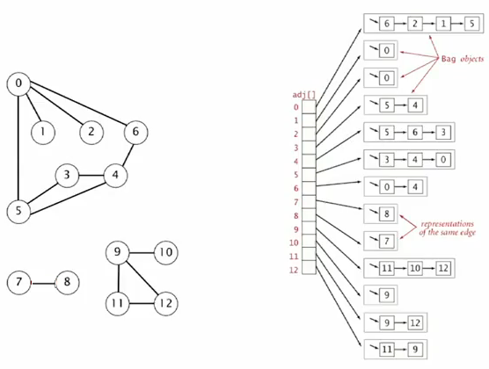
Adjacency List
A more space-efficient way to implement a sparsely connected graph is to use an adjacency list.

Slide 24
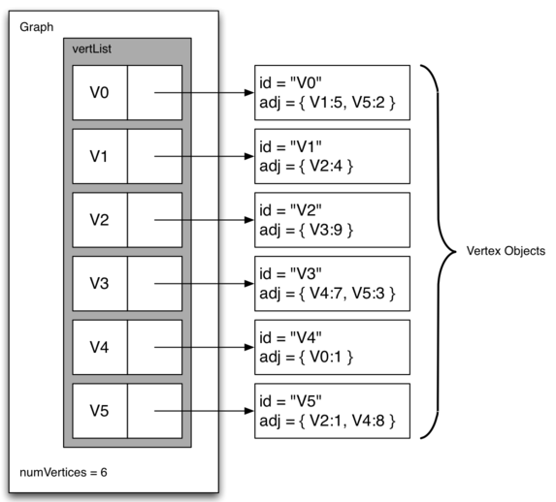
Adjacency List (cont…)

Slide 25
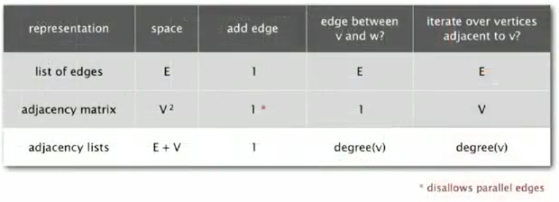

Slide 26
Depth-first search
Finds a path between two vertices by exploring each possible path as many steps as possible before backtracking.
Think of this algorithm as the process of searching through a maze.

Slide 27
One trick for exploring a maze without getting lost that has been known since antiquity (dating back at least to the legend of Theseus and the Minotaur) is known as Tremaux exploration. To explore all passages in a maze:
Take any unmarked passage, unrolling a string behind you.
Mark all intersections and passages when you first visit them.
Retrace steps (using the string) when approaching a marked intersection.
Retrace steps when no unvisited options remain at an intersection encountered while retracing steps.

Slide 28
dfs(Vertex v):
mark v as visited
for each unvisited neighbor v_{i} of v
where there is an edge from v to v_{i}:
if( !v_{i}.visited )
dfs(v_{i})

Slide 29
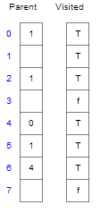
Visualization
https://www.cs.usfca.edu/~galles/visualization/DFS.html

Slide 30
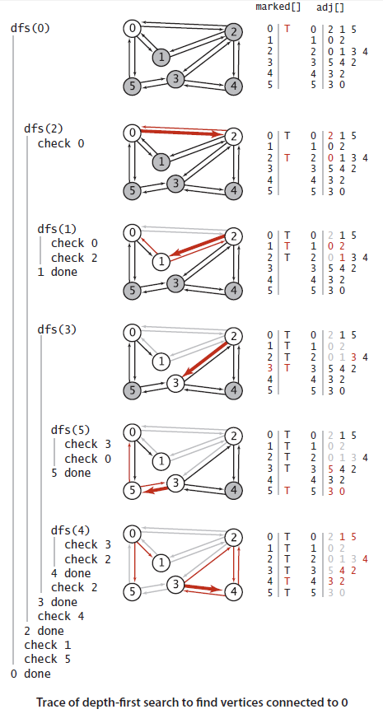

Slide 31
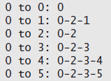
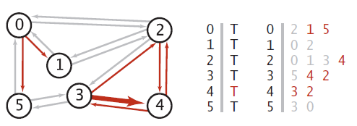
DFS Can be used to find the paths from one vertex to the other
Puts unvisited vertices on a stack.

Slide 32
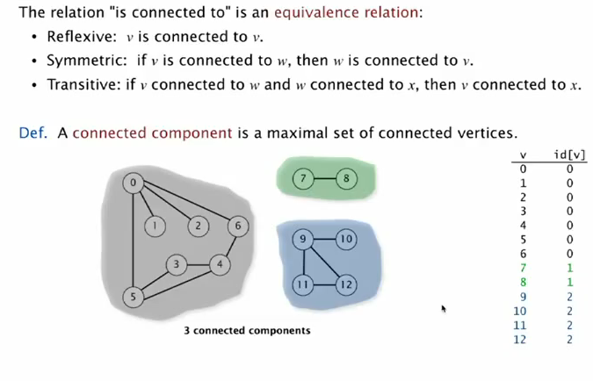
Connected Components

Slide 33
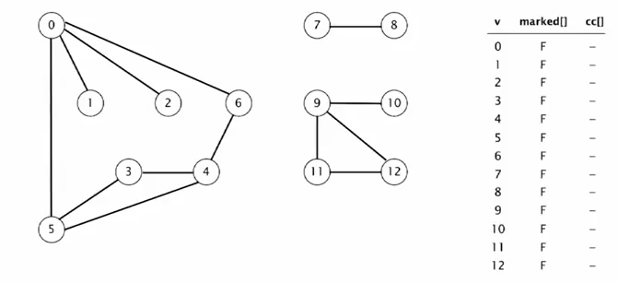
Connected Components (cont..)

Slide 34
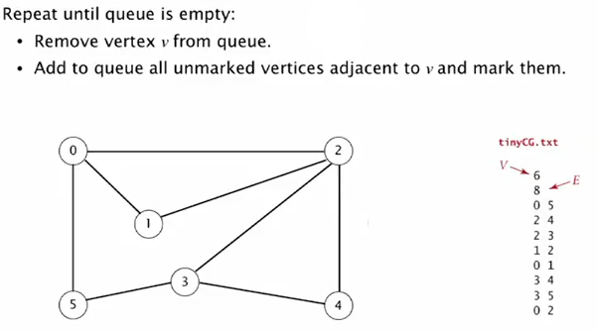
Breadth First Search

Slide 35
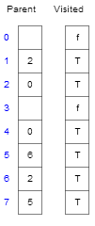
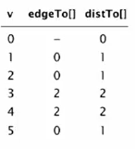
Visualization
https://www.cs.usfca.edu/~galles/visualization/BFS.html
OR

Slide 36
Breadth First Search (cont…)
Use a queue to keep track of which node you are currently at.
Puts unvisited vertices on a queue.
Single-source shortest paths. Given a graph and a source vertex s, support queries of the form Is there a path from s to a given target vertex v? If so, find a shortest such path (one with a minimal number of edges).

Slide 37
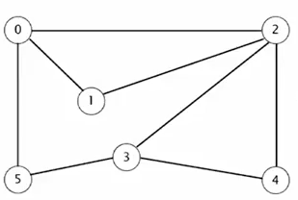

Slide 38
1 procedure BFS(G,v) is
2 create a queue Q
3 create a vector set V
4 enqueue v onto Q
5 add v to V
6 while Q is not empty loop
7 t ← Q.dequeue()
8 if t is what we are looking for then
9 return t
10 end if
11 for all edges e in G.adjacentEdges(t) loop
12 u ← G.adjacentVertex(t,e)
13 if u is not in V then
14 add u to V
15 enqueue u onto Q
16 end if
17 end loop
18 end loop
19 return none
20 end BFS

Slide 39
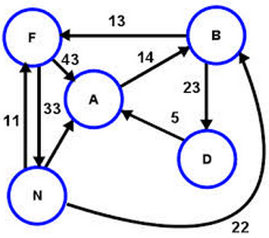
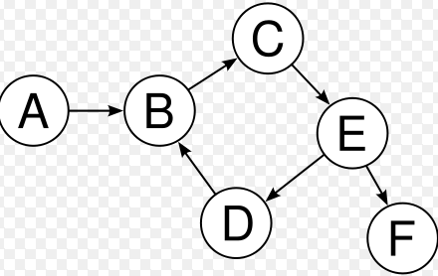
Directed Graphs
In directed graphs, edges are one-way.

Slide 40
The outdegree of a vertex in a digraph is the number of edges going from it; the indegree of a vertex is the number of edges going to it.
The first vertex in a directed edge is called its head ; the second vertex is called its tail.
A directed path in a digraph is a sequence of vertices in which there is a (directed) edge pointing from each vertex in the sequence to its successor in the sequence.

Slide 41
A directed cycle is a directed path with at least one edge whose first and last vertices are the same.
A simple cycle is a cycle with no repeated edges or vertices (except the requisite repetition of the first and last vertices).
The length of a path or a cycle is its number of edges.

Slide 42
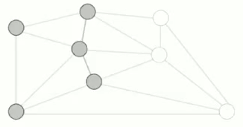
Algorithms to find MST
Cut property: A cut in a graph is a partition of its vertices into two nonempty sets.
For example, given the graph above, we have partitioned it by coloring some vertices grey.

Slide 43
Crossing edge: Connects a vertex in one set with a vertex in the other set.
Which are the crossing edges in the above? (Hint: There are 6).
Given any cut, the crossing edge of min weight is in a Minimum Spanning Tree.

Slide 44
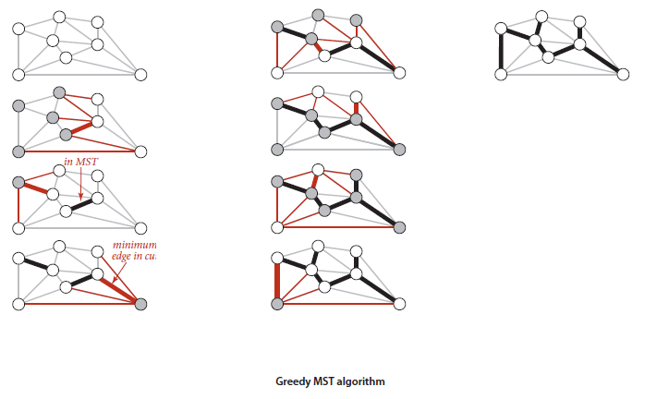
Greedy Algorithm
Starting with all edges colored gray, find a cut with no black edges, color its minimum-weight edge black, and continue until V-1 edges have been colored black.

Slide 45
Kruskal’s Algorithm
Order the edges by increasing weight.
Mark the edge black IF it does not create a cycle.
Special case of greedy algorithm
Use priority Queue

Slide 47
Prim’s algorithm
Start with the first vertex (E.g. vertex 0).
Add the minimum weighted edge to the MST which has only one endpoint in the Tree.
Also uses PQ

Slide 48
The other ppt

Slide 49
There are two implementations of Prim’s algorithm:
Lazy: Leaves an edge with a larger weight on the priority queue.
Eager: Does not add an edge to the PQ if there is a better way (i.e. with less weight) to a vertex.

Slide 50
Dijkstra

Slide 51
Example: Initialization
Distance(source) = 0
0
∞
Distance (all vertices but source) =
A
2
B
∞
4
1
3
10
∞
C
2
D
2
E
∞
5
8
∞
4
6
F
1
G
∞
∞
Pick vertex in List with minimum distance.

Slide 52
Example: Update neighbors' distance
0
2
A
2
B
4
1
3
10
∞
C
2
D
2
E
∞
5
8
1
4
6
Distance(B) = 2
F
1
G
Distance(D) = 1
∞
∞

Slide 53
Example: Remove vertex with minimum distance
0
2
A
2
B
4
1
3
10
∞
C
2
D
2
E
∞
5
8
1
4
6
F
1
G
∞
∞
Pick vertex in List with minimum distance, i.e., D

Slide 54
Example: Update neighbors
0
2
A
2
B
4
1
3
10
3
C
2
D
2
E
3
5
8
1
4
6
Distance(C) = 1 + 2 = 3 Distance(E) = 1 + 2 = 3 Distance(F) = 1 + 8 = 9 Distance(G) = 1 + 4 = 5
F
1
G
9
5

Slide 55
Example: Continued...
Pick vertex in List with minimum distance (B) and update neighbors
0
2
A
2
B
4
1
3
10
3
C
2
D
2
E
3
5
8
1
4
6
Note : distance(D) not updated since D is already known and distance(E) not updated since it is larger than previously computed
F
1
G
9
5

Slide 56
Example: Continued...
Pick vertex List with minimum distance (E) and update neighbors
0
2
A
2
B
4
1
3
10
3
C
2
D
2
E
3
5
8
1
4
6
F
1
G
No updating
9
5

Slide 57
Example: Continued...
Pick vertex List with minimum distance (C) and update neighbors
0
2
A
2
B
4
1
3
10
3
C
2
D
2
E
3
5
8
1
4
6
Distance(F) = 3 + 5 = 8
F
1
G
8
5

Slide 58
Example: Continued...
Pick vertex List with minimum distance (G) and update neighbors
0
2
A
2
B
4
1
3
10
3
C
2
D
2
E
3
5
8
1
4
6
F
1
G
Previous distance
6
5
Distance(F) = min (8, 5+1) = 6

Slide 59
Example (end)
0
2
A
2
B
4
1
3
10
3
C
2
D
2
E
3
5
8
1
4
6
F
1
G
6
5
Pick vertex not in S with lowest cost (F) and update neighbors

Slide 60
Correctness
Dijkstra’s algorithm is a greedy algorithm
make choices that currently seem the best
locally optimal does not always mean globally optimal
Correct because maintains following two properties:
for every known vertex, recorded distance is shortest distance to that vertex from source vertex
for every unknown vertex v, its recorded distance is shortest path distance to v from source vertex, considering only currently known vertices and v

Slide 61

“Cloudy” Proof: The Idea
Least cost node
Next shortest path from inside the known cloud
v
THE KNOWN
CLOUD
competitor
v'
Source
If the path to v is the next shortest path, the path to v' must be at least as long. Therefore, any path through v' to v cannot be shorter!

Slide 62
References
http://www.dcs.gla.ac.uk/~pat/52233/slides/Graphs1x1.pdf
http://interactivepython.org/courselib/static/pythonds/Graphs/graphintro.html

